Slide 1

CareAssist : Medical Billing and Claims Management System
JAVA FSD TRAINING BATCH – FEB 2026
NAME: GOPIKA N
TRAINER NAME: JAVEED

Slide 2
Case Study Statement
The Medical Billing and Claims Management System is a comprehensive application designed to streamline the complex process of medical billing, claims submission, and reimbursement for healthcare providers, insurance companies, and patients.
The system aims to reduce administrative burdens, improve accuracy, and enhance communication between stakeholders.
Scope:
1. Efficient Claims Submission: Develop a system for healthcare providers to submit accurate and timely insurance claims.
2. Claims Processing: Enable insurance companies to process claims, validate coverage, and reimburse healthcare providers.
3. Patient Invoicing: Generate and manage invoices for patients based on their medical services and insurance coverage.

Slide 3
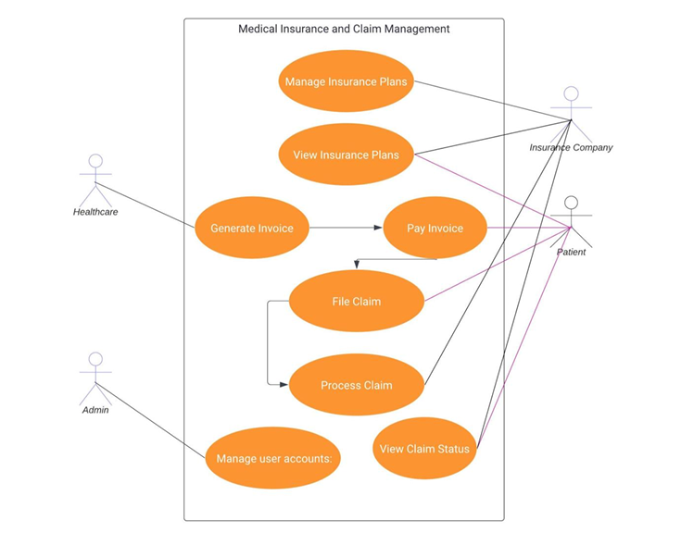
USECASE DIAGRAM

Slide 4
TECHNOLOGIES USED
Database
Used for storing data
MySQL (or your DB) – Relational database
SQL – Queries for data operations
Security
Used for authentication & authorization
JWT (JSON Web Token) – Secure authentication
Spring Security
Build & Dependency Tools
Maven – Project build & dependency management
Version Control
Git – Version control system
GitHub – Code repository
Development Tools
VS Code – Frontend development
Eclipse / IntelliJ IDEA – Backend development
Frontend Technologies
Used for UI & user interaction
React.js – Build dynamic user interfaces
JavaScript (ES6) – Logic & functionality
HTML5 – Structure of web pages
CSS3 – Styling and responsive design
Axios / Fetch API – API communication
Backend Technologies
Used for server-side logic
Spring Boot – Backend framework
Spring Core – Dependency Injection (DI), IoC
Spring MVC – Request handling
Spring Data JPA – Database interaction
Hibernate – ORM framework
REST API – Communication between frontend & backend
API Testing Tools
Postman – Testing REST APIs

Slide 5
PROJECT MODULES

